Slide 1
Advanced usages of Flux
Emanuele Della Valle
Prof. @ Politecnico di Milano
Founder & Partner @ Quantia Consulting
Marco Balduini
Founder & CEO @ Quantia Consulting
Riccardo Tommasini
Prof. @ University of Tartu

Slide 2
Manipulate timestamps

Slide 3
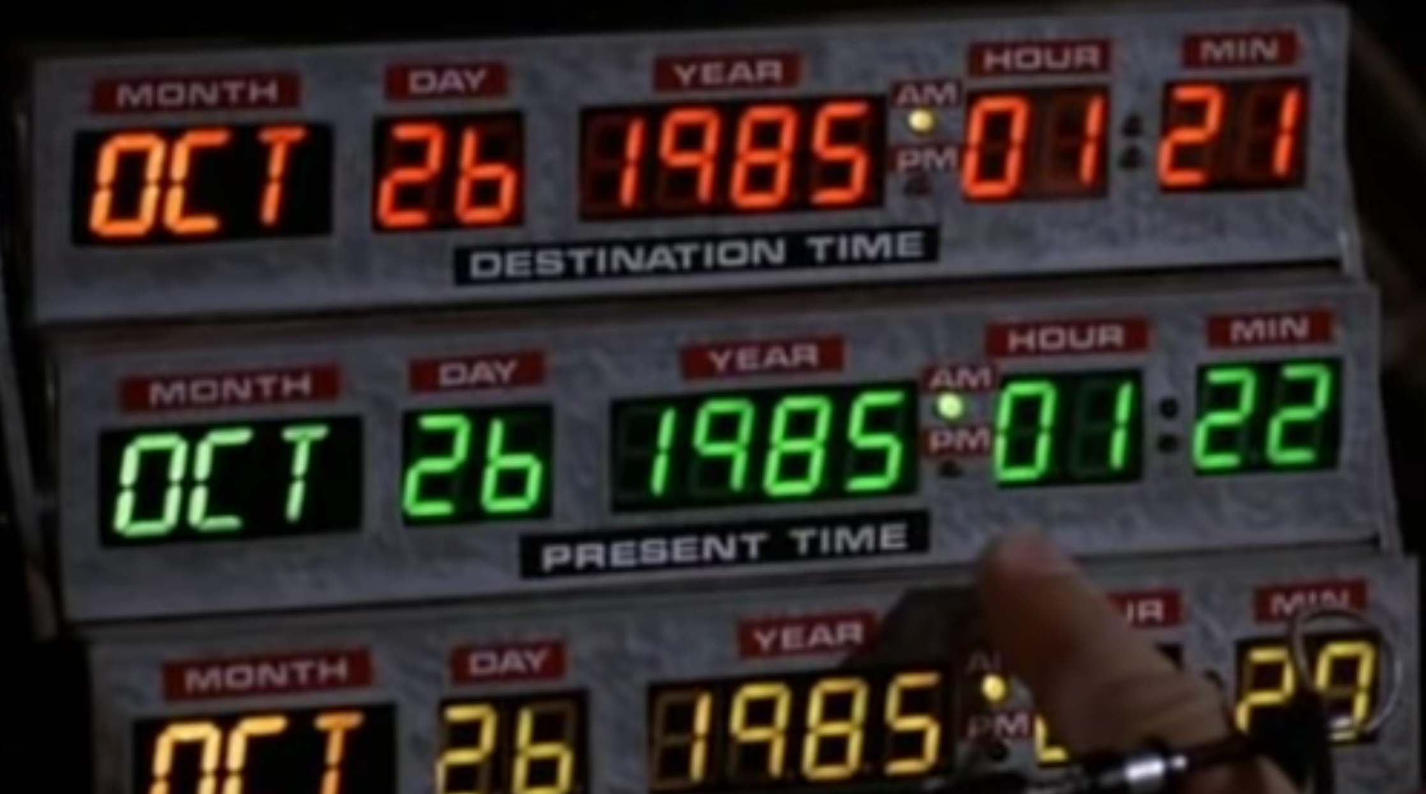

Slide 4
Manipulate timestamps
Every point stored in InfluxDB has an associated timestamp.
Flux can process and manipulate timestamps:
Normalize irregular timestamps
Convert timestamp format
Calculate the duration between two timestamps
Use timestamps and durations together

Slide 5
Manipulate timestamps
Every point stored in InfluxDB has an associated timestamp.
Flux can process and manipulate timestamps:
Normalize irregular timestamps
Convert timestamp format
Calculate the duration between two timestamps
Use timestamps and durations together

Slide 6
Convert timestamp format
time() converts Unix nanosecond to RFC3339
- time(v: -446090160000000000) // Returns 1955-11-12T22:04:00.000000000-07:00
unit() converts RFC3339 to Unix nanosecond
- uint(v: 1955-11-12T22:04:00.000000000-07:00) // Returns -446090160000000000

Slide 7
Calculate the duration between two timestamps
Flux doesn’t support operations among time values
To calculate the duration between two timestamps:
Use the uint() function to convert timestamps to a Unix nanosecond
Subtract one Unix nanosecond from the other
Use the duration() function to convert the result into a duration
E.g.,
time1 = uint(v: 1955-11-12T22:04:00.000000000-07:00)
time2 = uint(v: 1955-05-12T07:00:00.000000000-07:00)
duration(v: time2 - time1)
// Returns 6d15h4m

Slide 8
Use timestamps and durations together
experimental.addDuration() adds a duration to a timestamp
experimental.subDuration() subtracts a duration from a timestamp
import "experimental”
experimental.addDuration(
d: 6d15h4m,
to: 1955-05-12T07:00:00.000000000-07:00)
// Returns 1955-11-12T22:04:00.000000000-07:00
experimental

Slide 9
Anomaly Detection

Slide 10
Anomaly Detection
Anomaly detection is a challenging data analysis task
Anomalies can represent
spurious data to clean out
important patterns to detect
This generality makes anomaly detection a powerful tool used in network security, remote sensing, fault detection, and many other domains

Slide 11
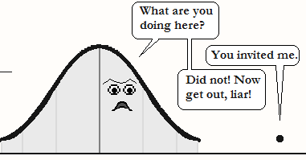
Anomaly Detection – the intuition
Considering the distribution of the data point in a time series, anomalous points are anomalies, a.k.a. outliers
[image: https://cerijayne.files.wordpress.com/2011/10/outliersss.png]

Slide 12
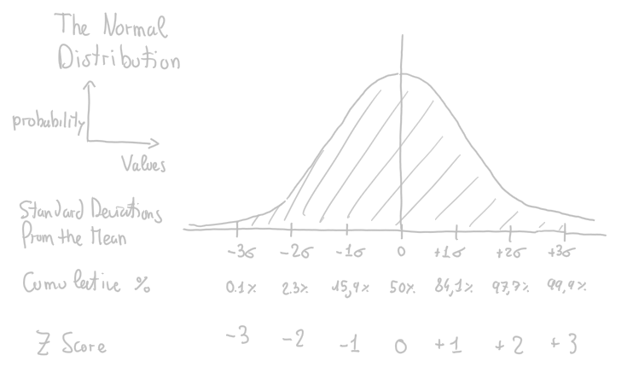
Let’s operationalize this intuition using the Z score
Z score
x – μ
σ
z
=

Slide 13
Let’s operationalize this intuition using the Z score
Z score
x – μ
σ
z
=
Anomaly
Abs(z) > 3
0.2% of data

Slide 14

A Network Security example
Finding anomalies in the number of times users inserts a wrong password when they log into a system
Refuse the access to a user that inserts the right password at the first time if she gets in average the right password after 3 attempts
Much more effective than any rule based approach

Slide 15
Use case for the Linear Pizza Oven
Alert me about any failure of the temperature controller of the mozzarella melting area
Correct behavior: it depends on the pizzas under production
Anomalous: ???

Slide 16
Use case for the Linear Pizza Oven
Alert me about any failure of the temperature controller of the mozzarella melting area
Correct behavior: it depends on the pizzas under production
Anomalous: let’s compute the z-score where
the Mean is computed with aggregateWindow(every: 5m, fn: mean)
the StdDev is computed with aggregateWindow(every: 5m, fn: stddev)
the Z score is computed joining the times-series of all observations with the one of the Mean and the one the StdDev

Slide 17
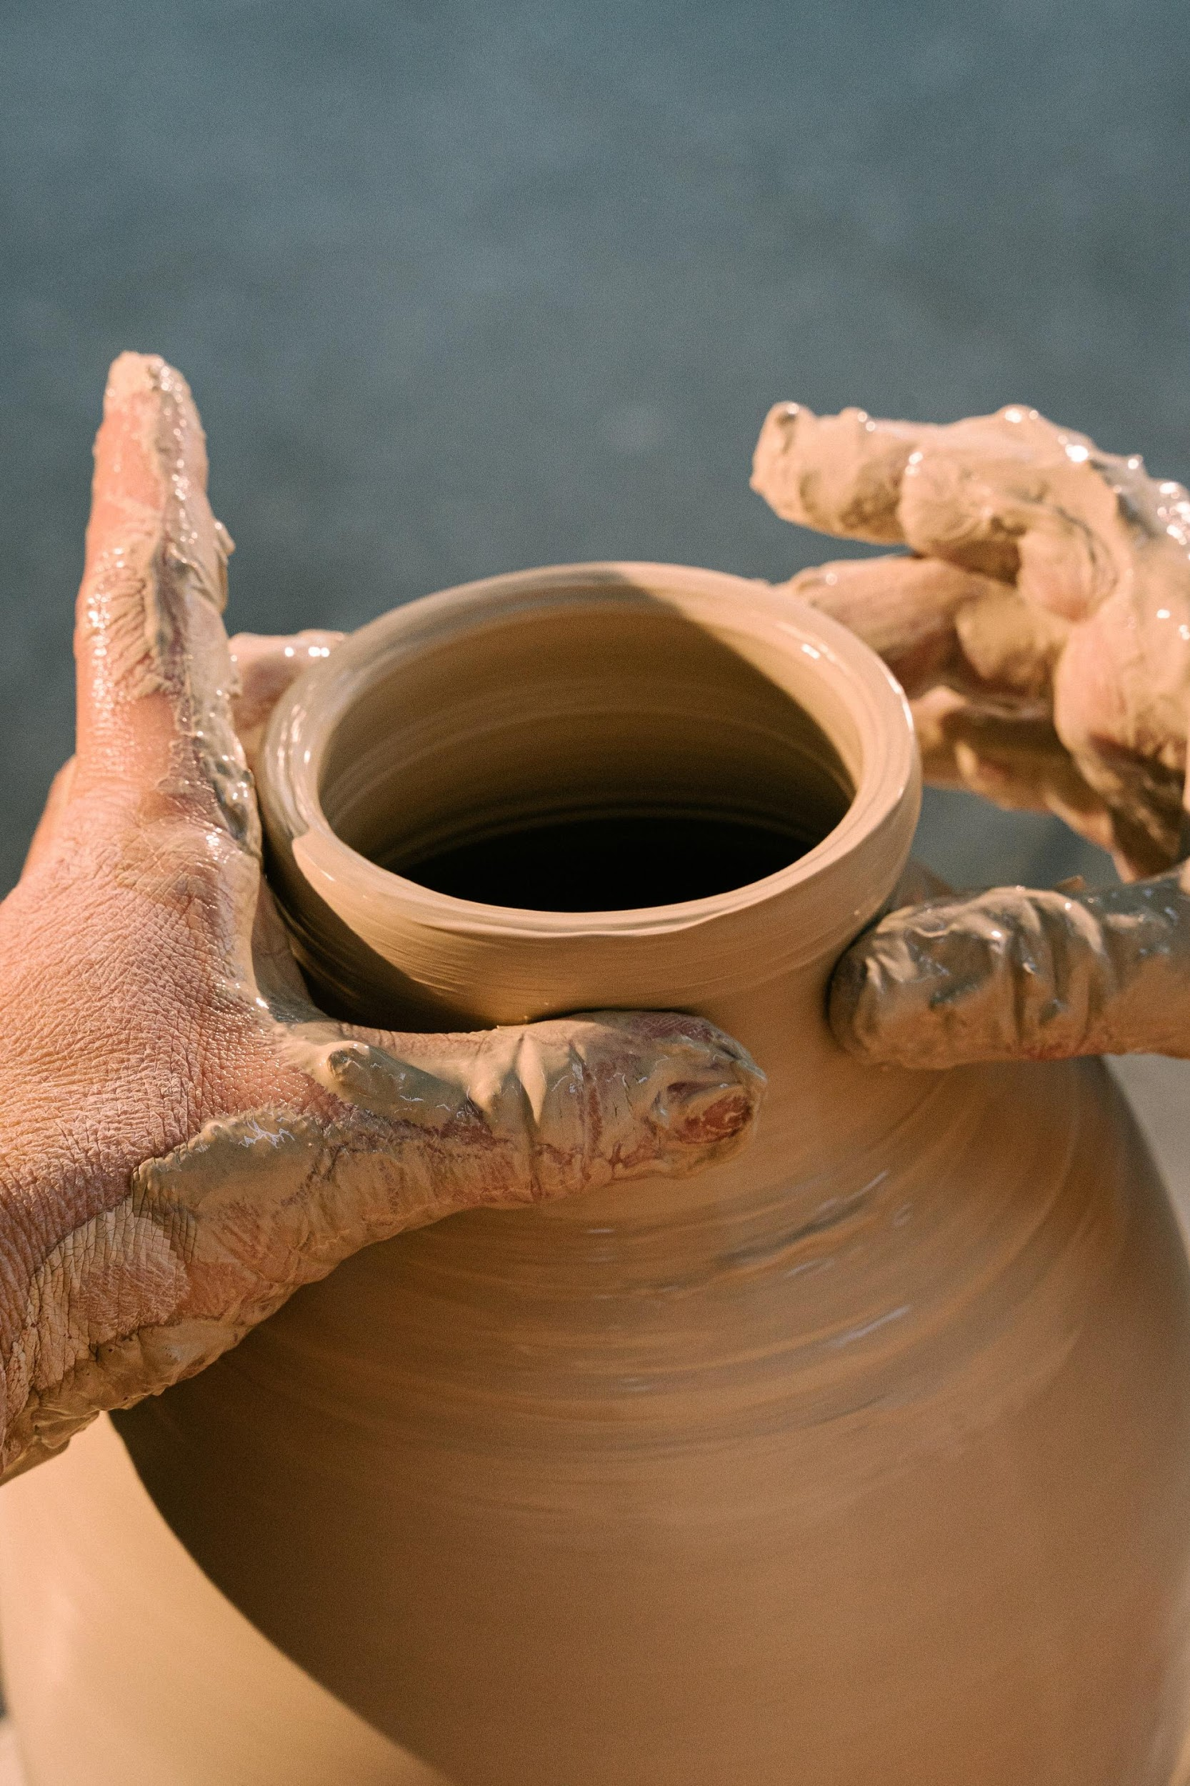
Let me explain it …

Slide 18
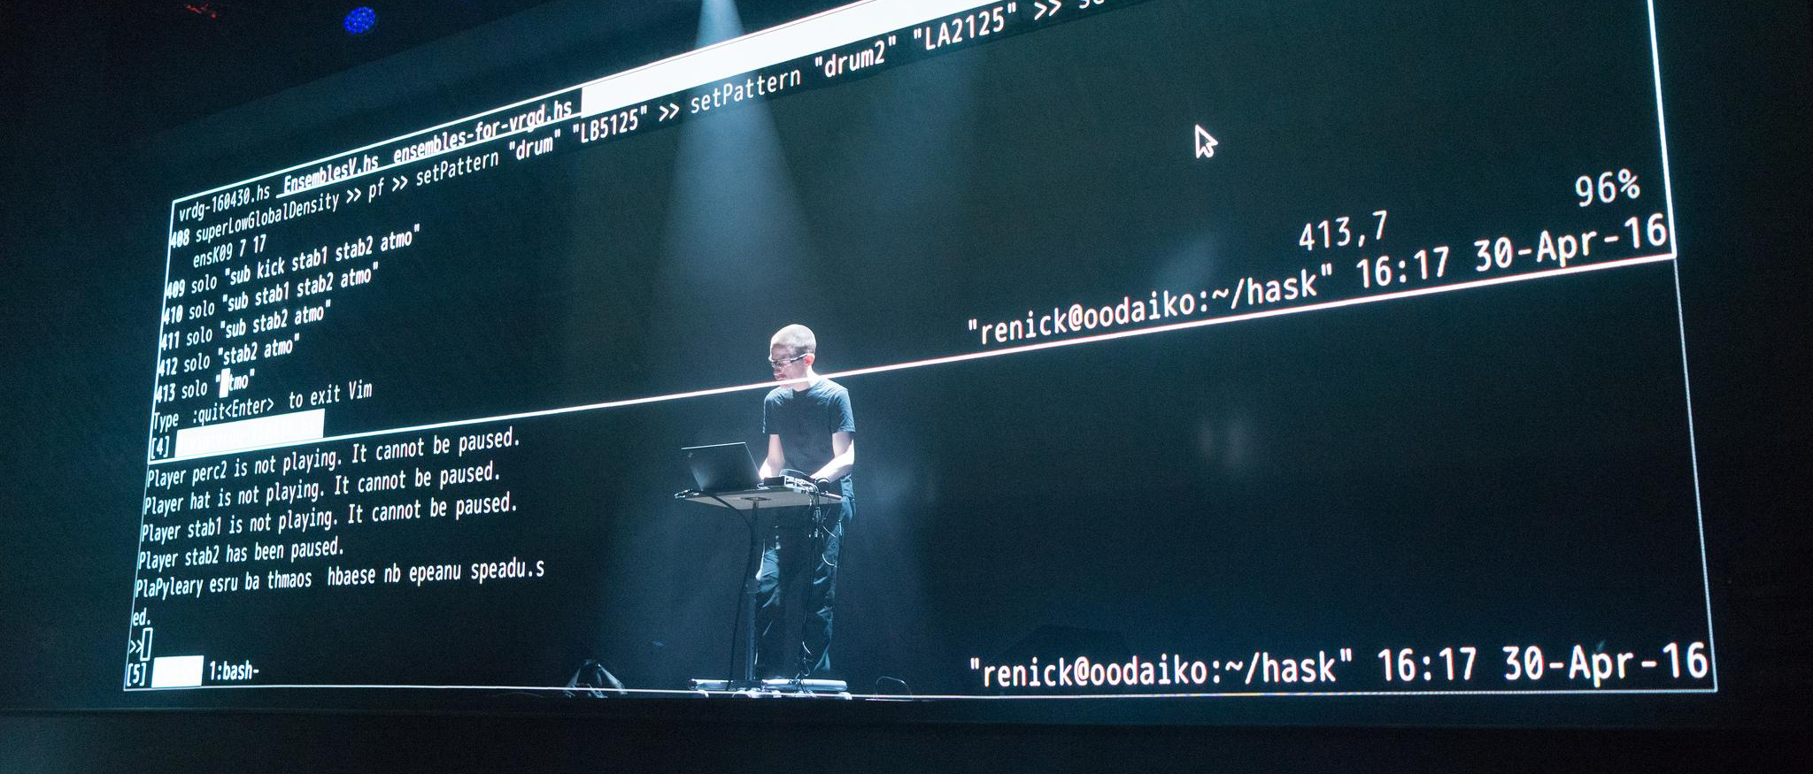
Let’s do some live coding

Slide 19
Use case for the Linear Pizza Oven – solution 1/5
movingAvg = from(bucket: "training")
|> range(start: v.timeRangeStart, stop: v.timeRangeStop)
|> aggregateWindow(every: 5m, fn: mean, createEmpty: false)
|> filter(fn: (r) => (r._stop != r._time))
|> drop(columns: ["_start", "_stop","host"])

Slide 20
Use case for the Linear Pizza Oven – solution 1/5
movingAvg = from(bucket: "training")
|> range(start: v.timeRangeStart, stop: v.timeRangeStop)
|> aggregateWindow(every: 5m, fn: mean, createEmpty: false)
|> filter(fn: (r) => (r._stop != r._time))
|> drop(columns: ["_start", "_stop","host"])

Slide 21
Use case for the Linear Pizza Oven – solution 2/5
movingStddev = from(bucket: "training")
|> range(start: v.timeRangeStart, stop: v.timeRangeStop)
|> aggregateWindow(every: 5m, fn: stddev, createEmpty: false)
|> filter(fn: (r) => (r._stop != r._time))
|> drop(columns: ["_start", "_stop","host"])

Slide 22
Use case for the Linear Pizza Oven – solution 2/5
movingStddev = from(bucket: "training")
|> range(start: v.timeRangeStart, stop: v.timeRangeStop)
|> aggregateWindow(every: 5m, fn: stddev, createEmpty: false)
|> filter(fn: (r) => (r._stop != r._time))
|> drop(columns: ["_start", "_stop","host"])

Slide 23
Use case for the Linear Pizza Oven – solution 3/5
movingModel =
join(tables: {avg: movingAvg, stddev: movingStddev}, on: ["_field","_measurement","sensor"], method: "inner")
|> filter(fn: (r) => r._time_avg == r._time_stddev)
|> rename(columns: {_time_avg: "_time"})
|> drop(columns: ["_time_stddev"])

Slide 24
Use case for the Linear Pizza Oven – solution 3/5
movingModel =
join(tables: {avg: movingAvg, stddev: movingStddev}, on: ["_field","_measurement","sensor"], method: "inner")
|> filter(fn: (r) => r._time_avg == r._time_stddev)
|> rename(columns: {_time_avg: "_time"})
|> drop(columns: ["_time_stddev"])

Slide 25
Use case for the Linear Pizza Oven – solution 4/5
allData = from(bucket: "training")
|> range(start: v.timeRangeStart, stop: v.timeRangeStop)
|> drop(columns: ["_start", "_stop", "host"])

Slide 26
Use case for the Linear Pizza Oven – solution 4/4
zscores =
join(tables: {all: allData, m: movingModel},
on: ["_field", "_measurement", "sensor"])
|> filter(fn: (r) => (uint(v: r._time_all) - uint(v: r._time_m) > 0))
|> filter(fn: (r) =>
(uint(v: r._time_all) - uint(v: r._time_m) <= 5*60*1000000000))
|> map(fn: (r) =>
({r with _value_zscore:
math.abs(x: (r._value - r._value_avg) / r._value_stddev)}))
|> rename(columns: {_time_all: "_time"})
E. Della Valle, M. Balduini, & R. Tommasini - Influx Days - Virtual - SF 2020

Slide 27
Use case for the Linear Pizza Oven – solution 4/4
zscores =
join(tables: {all: allData, m: movingModel},
on: ["_field", "_measurement", "sensor"])
|> filter(fn: (r) => (uint(v: r._time_all) - uint(v: r._time_m) > 0))
|> filter(fn: (r) =>
(uint(v: r._time_all) - uint(v: r._time_m) <= 5*60*1000000000))
|> map(fn: (r) =>
({r with _value_zscore:
math.abs(x: (r._value - r._value_avg) / r._value_stddev)}))
|> rename(columns: {_time_all: "_time"})
E. Della Valle, M. Balduini, & R. Tommasini - Influx Days - Virtual - SF 2020

Slide 28
Use case for the Linear Pizza Oven – solution 4/4
zscores =
join(tables: {all: allData, m: movingModel},
on: ["_field", "_measurement", "sensor"])
|> filter(fn: (r) => (uint(v: r._time_all) - uint(v: r._time_m) > 0))
|> filter(fn: (r) =>
(uint(v: r._time_all) - uint(v: r._time_m) <= 5*60*1000000000))
|> map(fn: (r) =>
({r with _value_zscore:
math.abs(x: (r._value - r._value_avg) / r._value_stddev)}))
|> rename(columns: {_time_all: "_time"})
E. Della Valle, M. Balduini, & R. Tommasini - Influx Days - Virtual - SF 2020

Slide 29
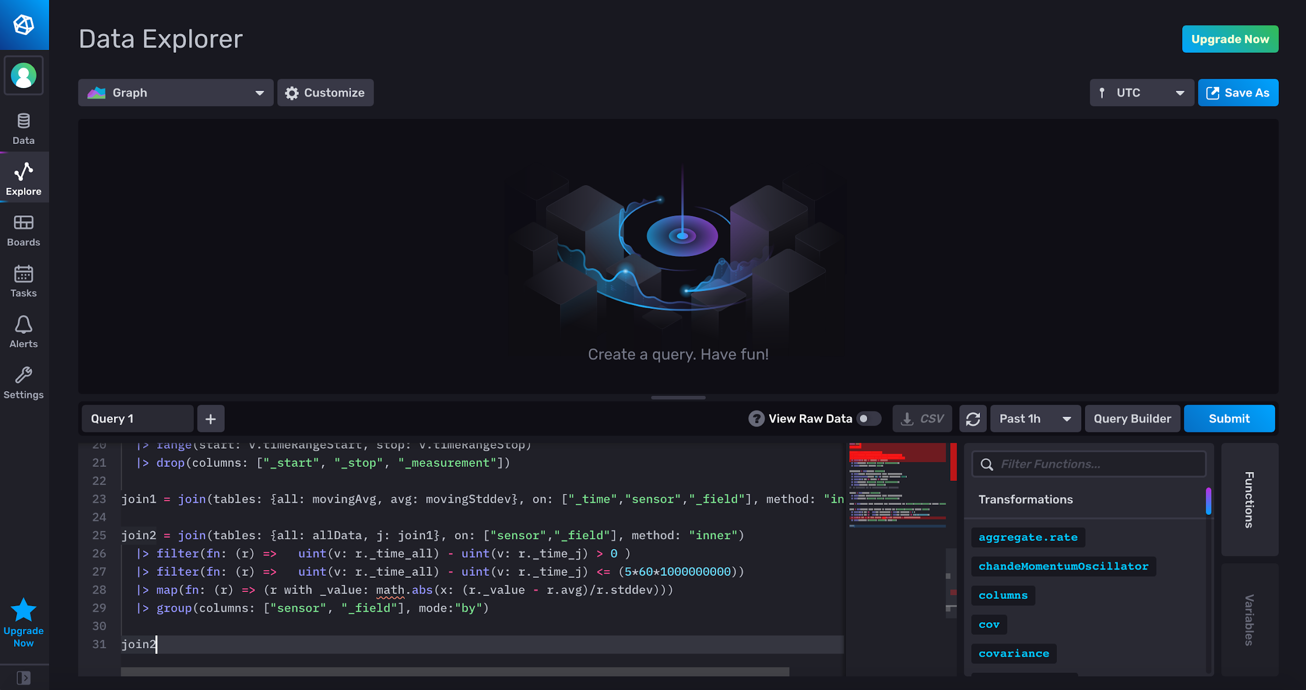
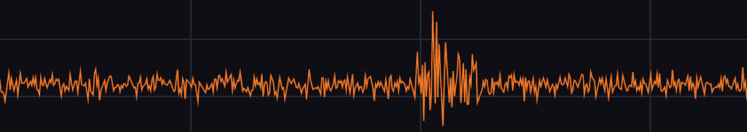

Visualizing the moving z-score

Slide 30
Time Series Enrichment

Slide 31
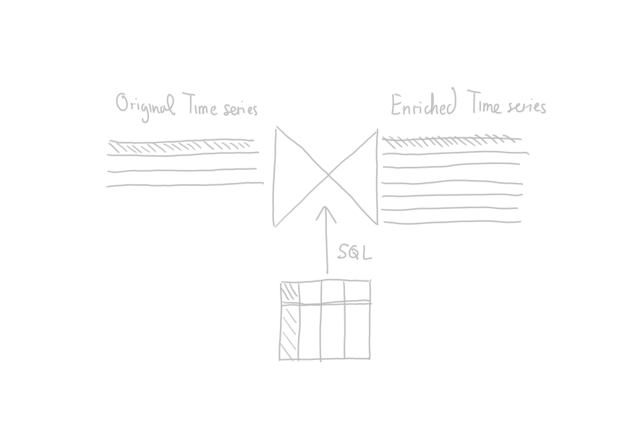
Time Series Enrichment – the intuition
IoT Sensors

Slide 32
Time Series Enrichment – the intuition
IoT Sensors
Enterprise Resource Planning

Slide 33
Time Series Enrichment – the intuition
IoT Sensors
Enterprise Resource Planning

Slide 34
Time Series Enrichment – the intuition
IoT Sensors
Enterprise Resource Planning

Slide 35
Time Series Enrichment – the intuition
I4.0 apps
IoT Sensors
Enterprise Resource Planning

Slide 36
Use case for the Linear Pizza Oven
Enrich the IoT observations with the ID of the pizza and the kind of pizza contained in the Enterprise Resource Planning RDBMS
This enables:
In the short term, full traceability of cooking conditions for each pizza
In the long term, prescriptive analytics for pizza quality control
Easy: control the pizzas that were in the oven when anomalous temperature alter went off
Hard: build a classifier that alerts for quality issues based on the past observations

Slide 37
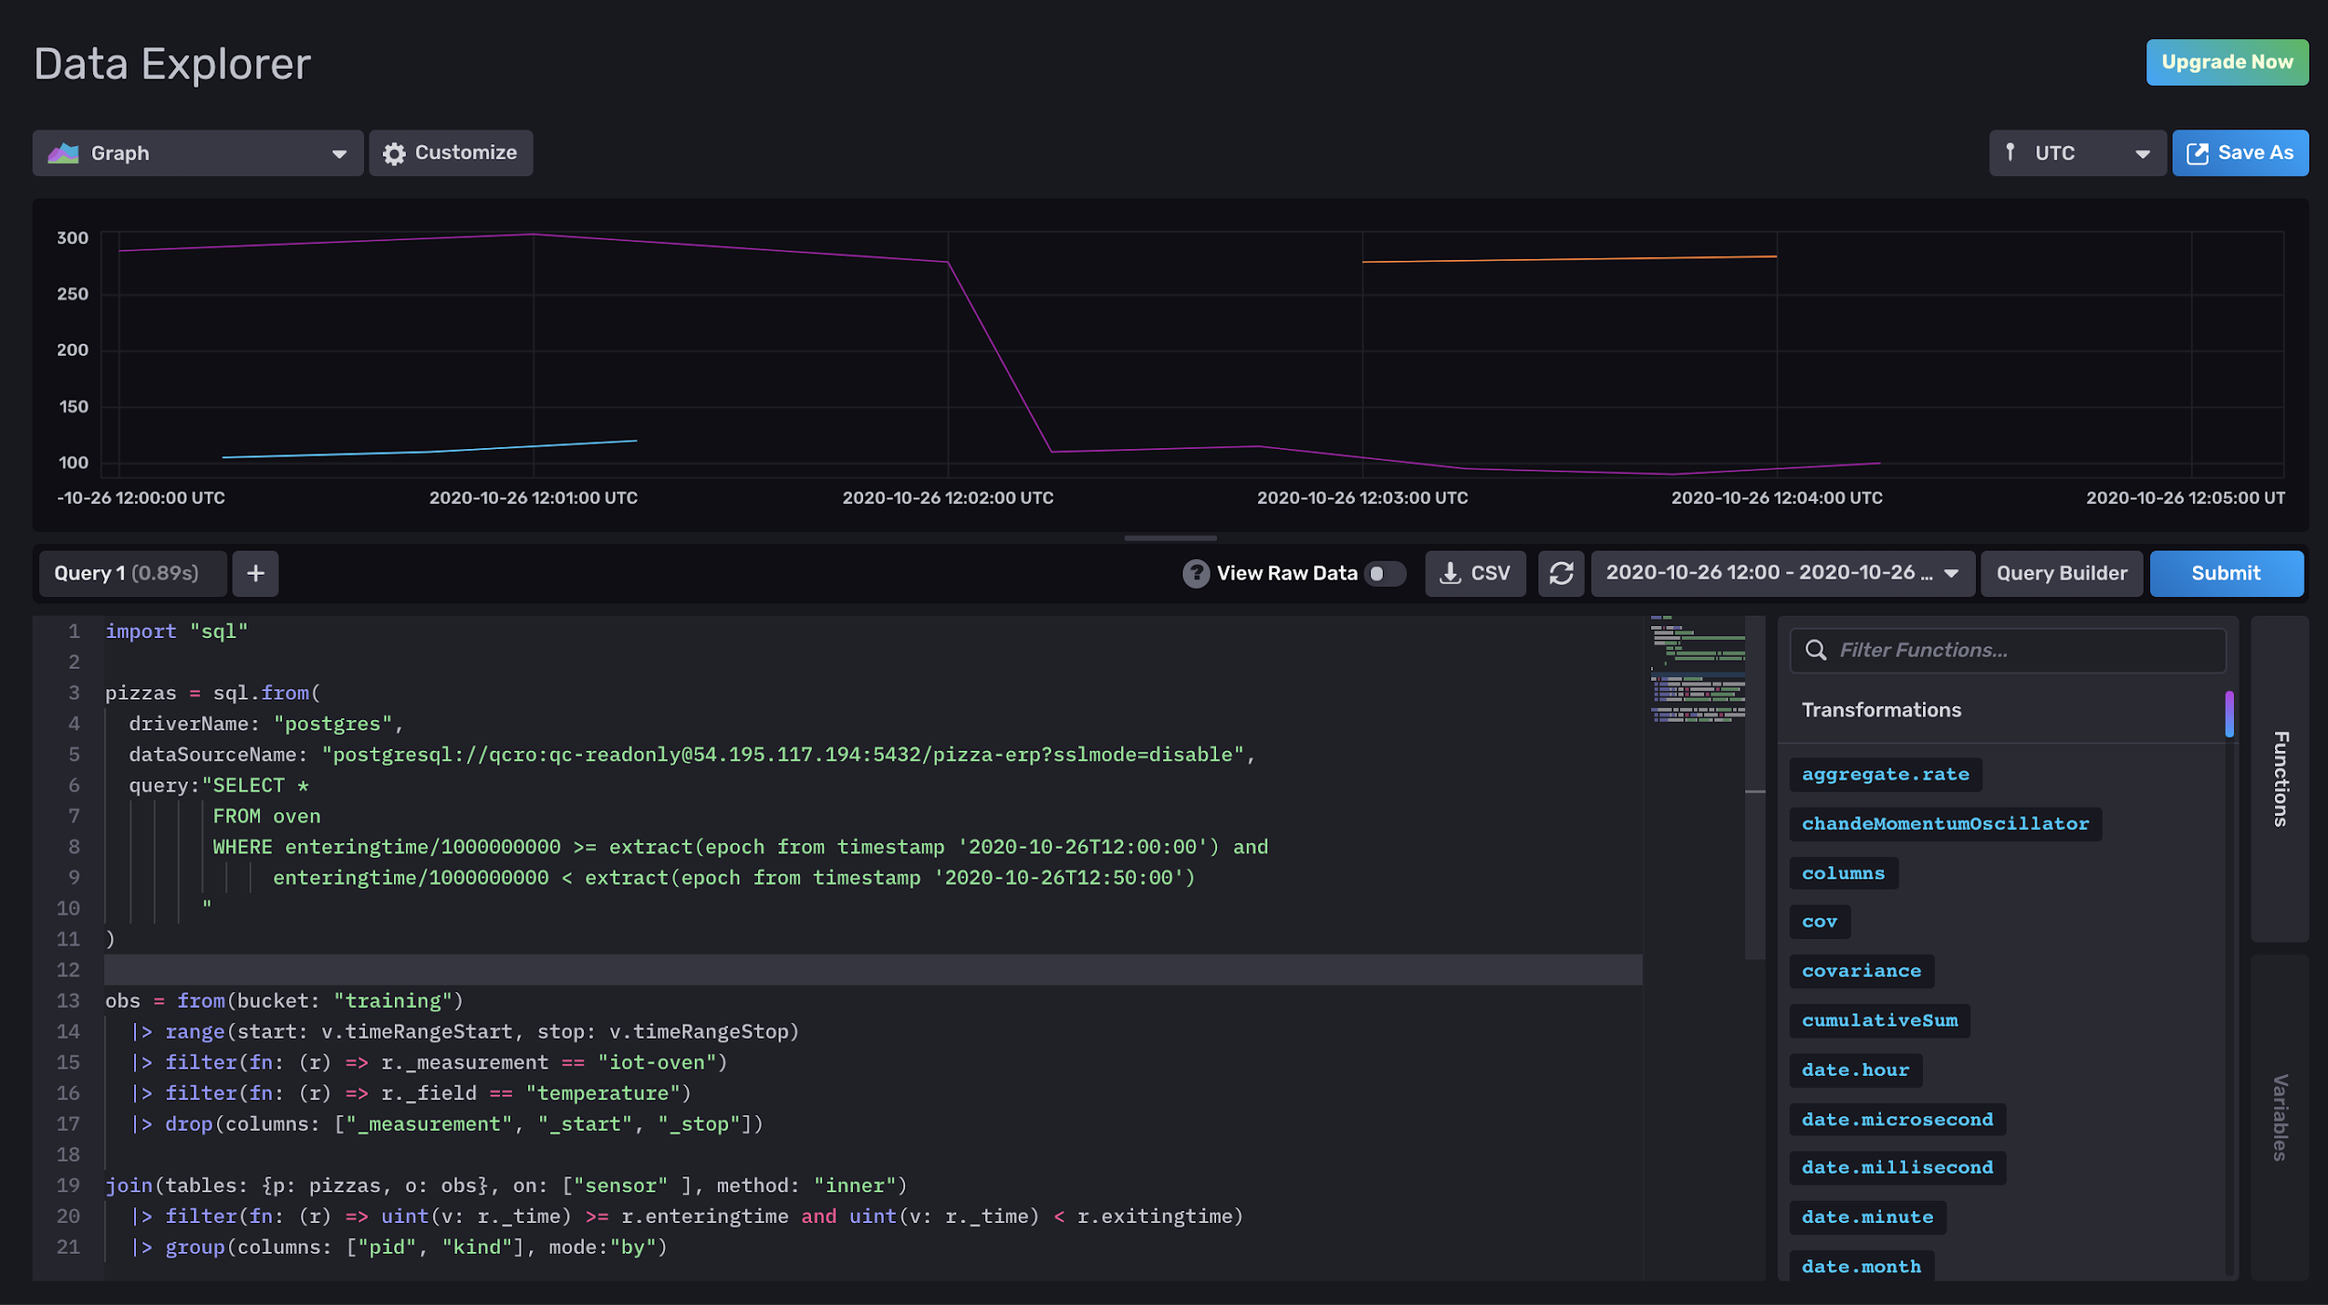
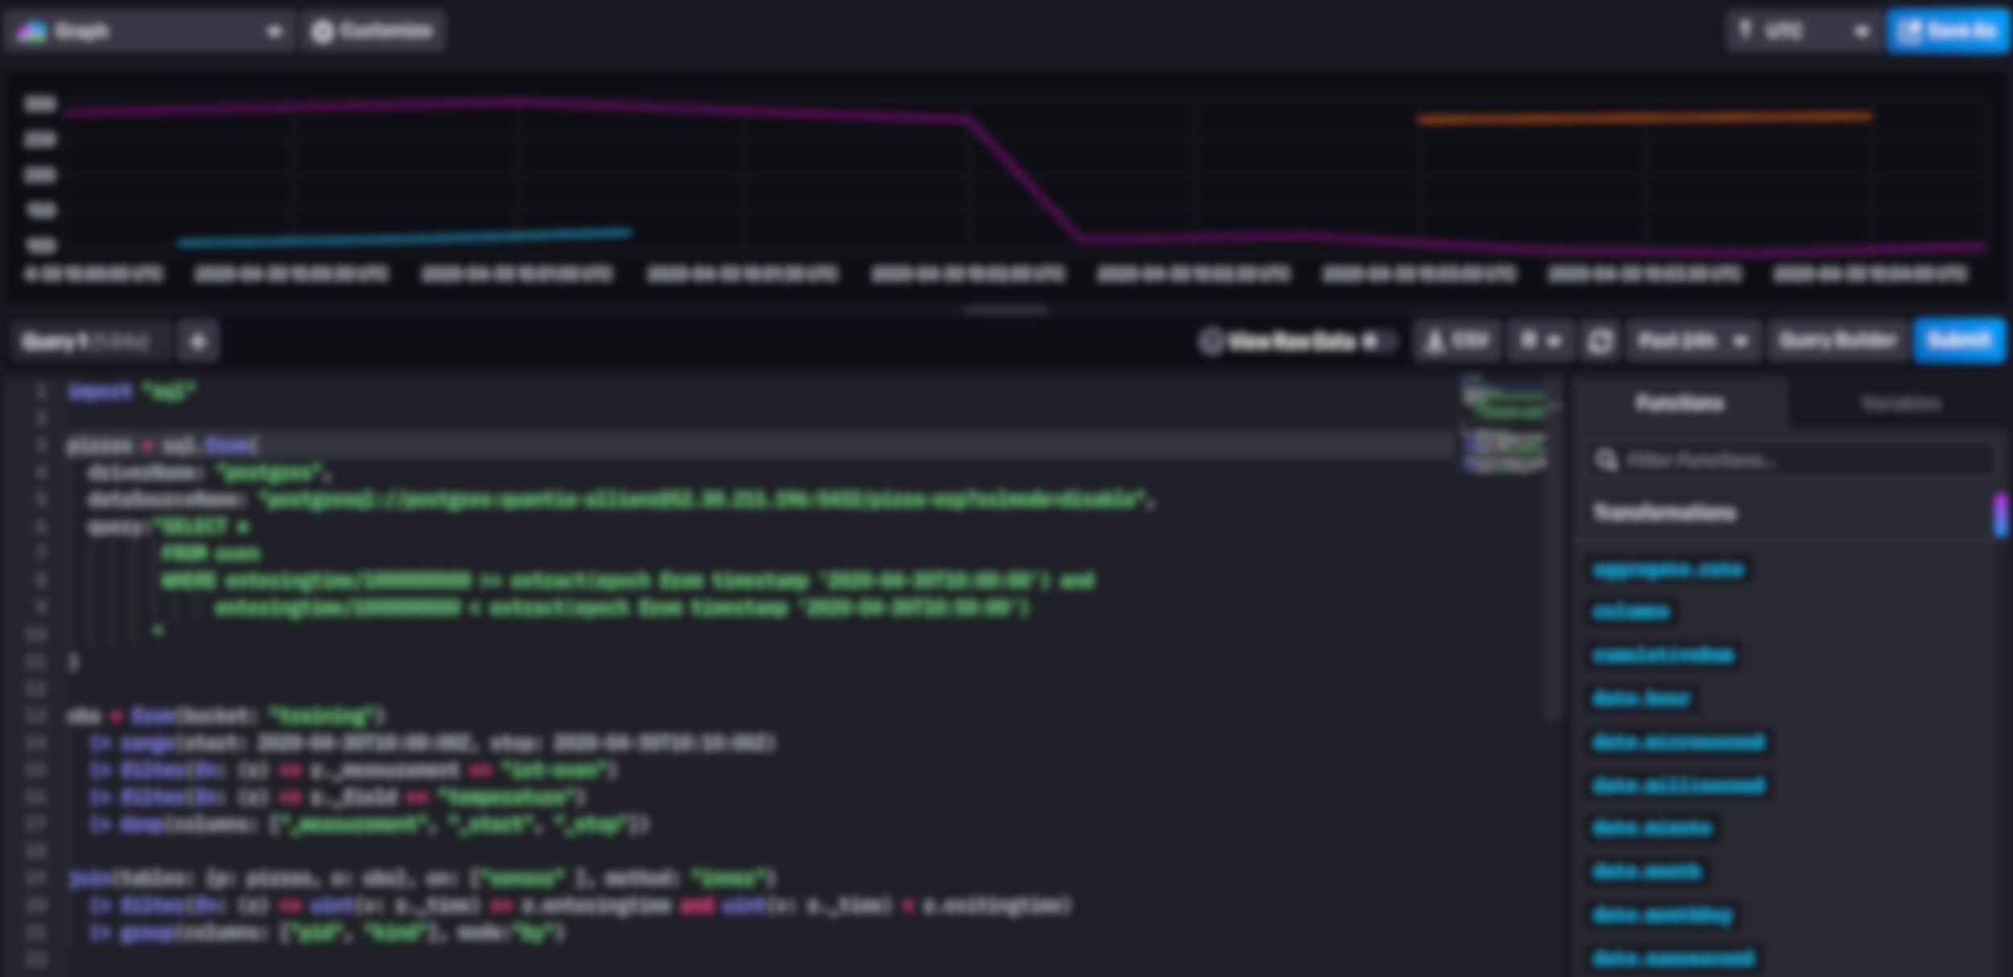
Time Series Enrichment in Flux

Slide 38
Let me explain it …

Slide 39
Let’s do some live coding

Slide 40
Advanced Time Series Analytics

Slide 41
Holt-Winter’s method
Given a time series
It is often possible to extract
a trend: a long term variation of the time series.
a seasonality: a short term recurring pattern
What is left is call residual

Slide 42
Forecasting with Holt-Winter’s method
Data

Slide 43
Forecasting with Holt-Winter’s method
Data
Fitted

Slide 44
Forecasting with Holt-Winter’s method
Data
Fitted
Forecast
Lower 2,5%
Upper 97,5%

Slide 45
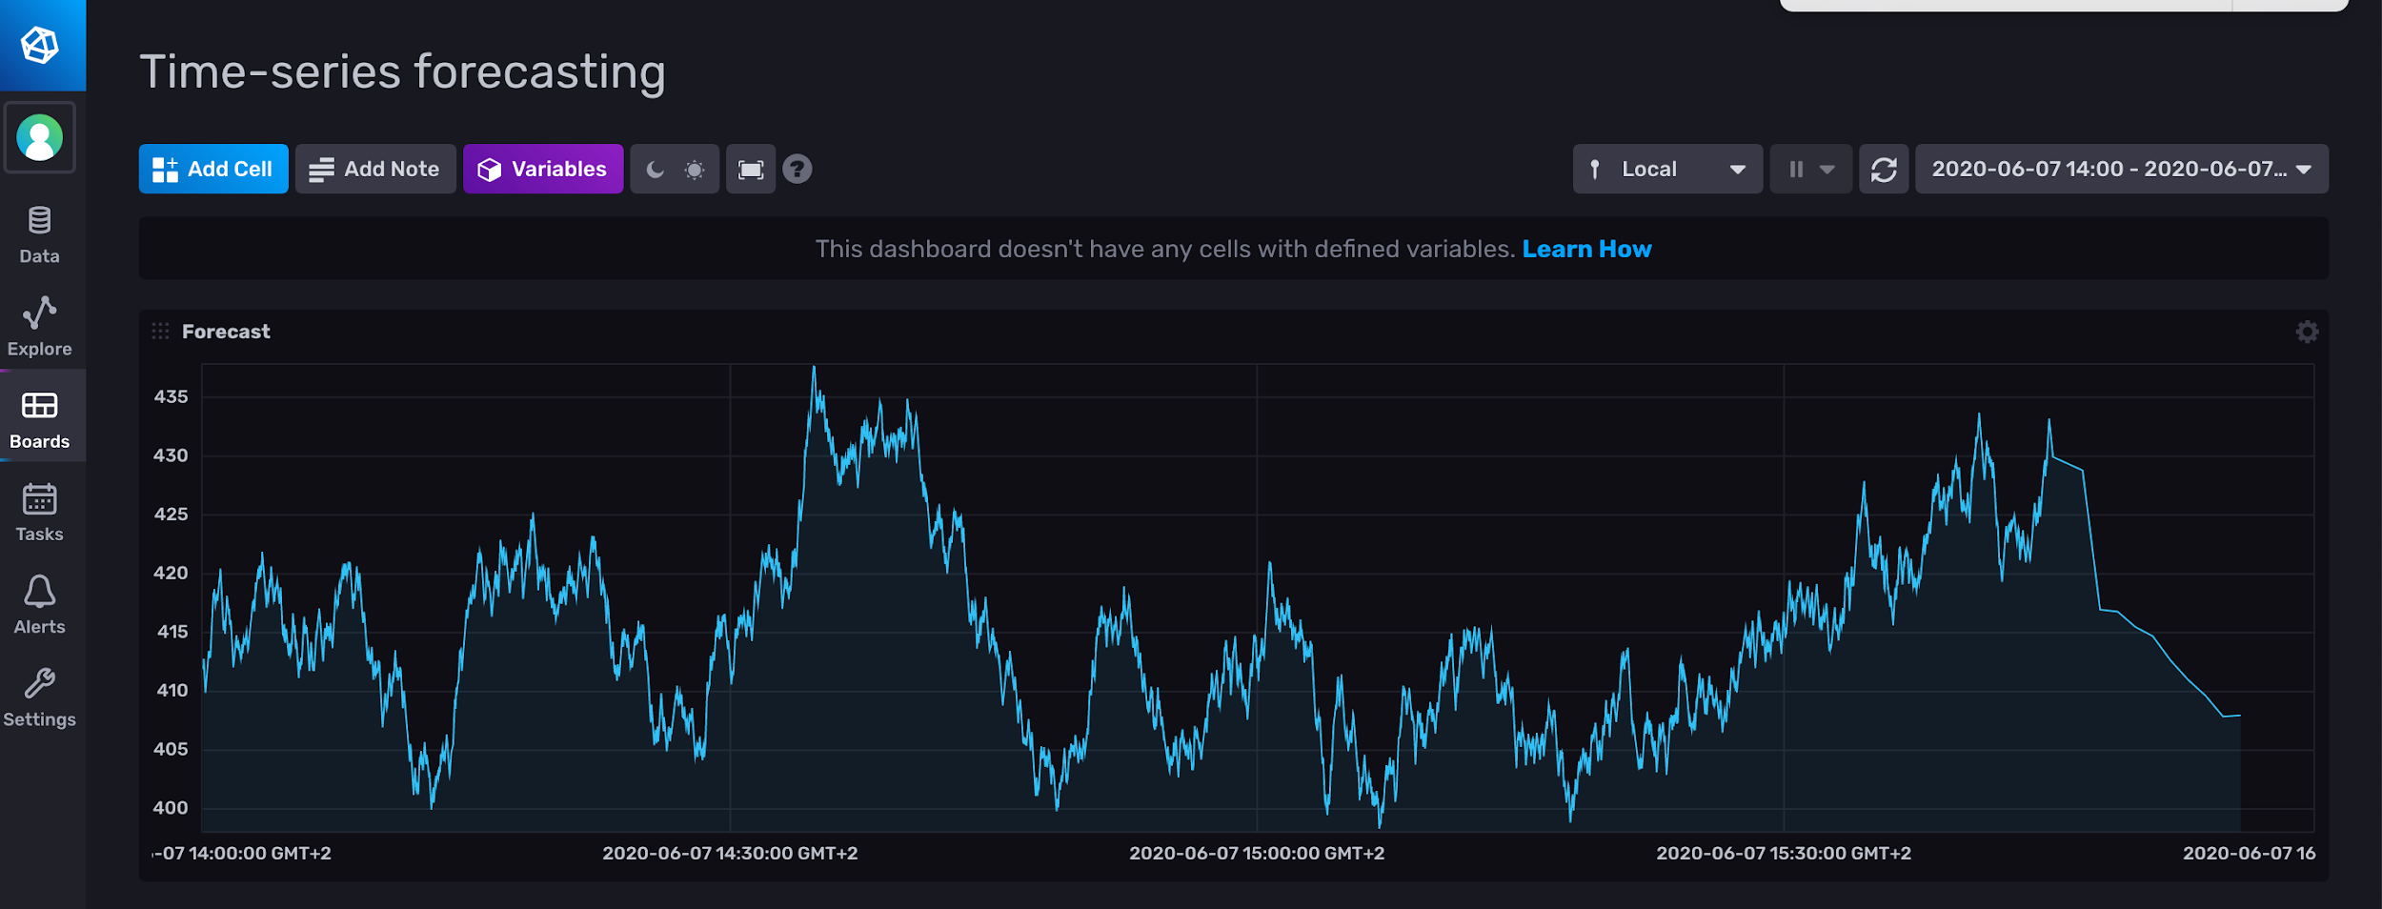
Holt-Winter’s in Flux

Slide 46
Holt-Winter’s in Flux
from(bucket: "training")
|> range(start: v.timeRangeStart, stop: v.timeRangeStop)
|> filter(fn: (r) => r._measurement == "fill_level")
|> filter(fn: (r) => r._field == "value")
|> filter(fn: (r) => r.tank == "B2")
|> aggregateWindow(every: 1m, fn: first)
|> holtWinters(n: 10, seasonality: 8, interval: 1m)

Slide 47
Let me explain it …

Slide 48
Let’s do some live coding

Slide 49
What (else) can I do with Flux?

Slide 50
What (else) can I do with flux?
Map/Reduce
Derivative, Difference, Integral
Histograms
Regular expression matching
String functions
Go Math library parity
Quantile
Conditional expressions
Sorting
Data Generation
In-language test assertions
…
And more every day!

Slide 51
Advanced usages of Flux
Emanuele Della Valle
Prof. @ Politecnico di Milano
Founder & Partner @ Quantia Consulting
Marco Balduini
Founder & CEO @ Quantia Consulting
Riccardo Tommasini
Prof. @ University of Tartu

